Slide 1



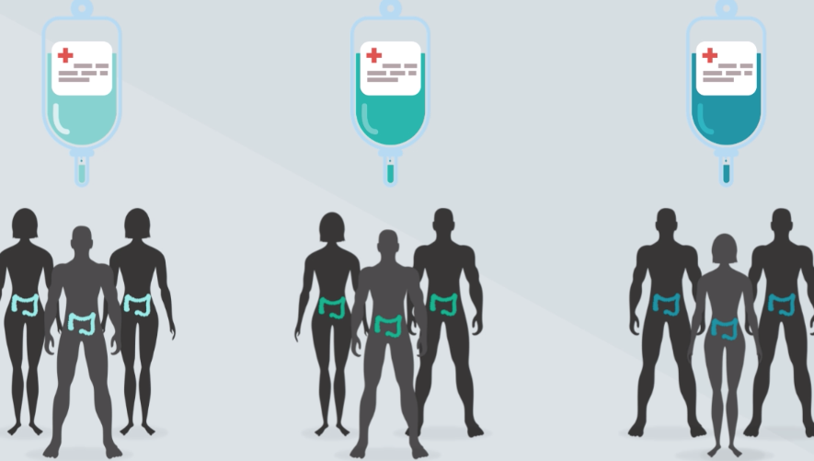
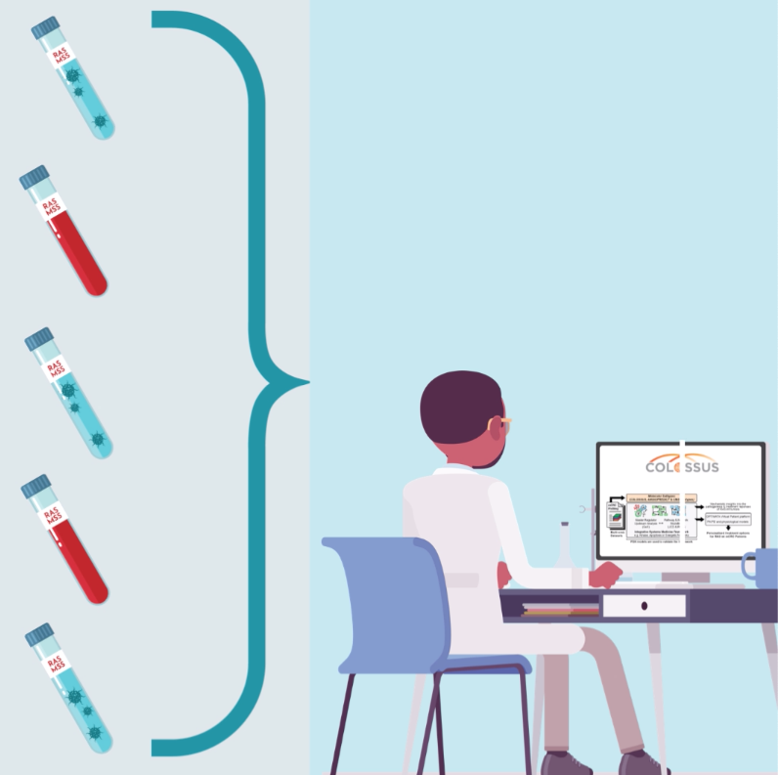
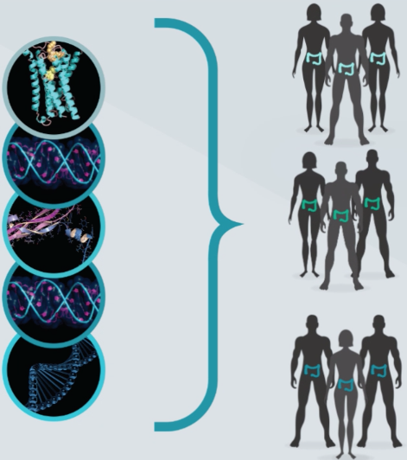
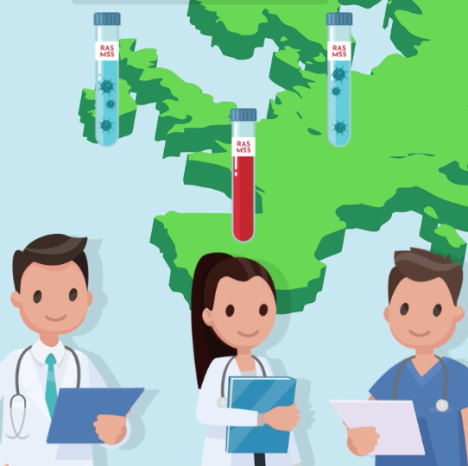














COLOSSUS has received funding from the
European Union’s Horizon 2020 research and innovation programme under grant agreement
no.754923.
Harnessing the power of systems biomedicine, network analysis
and computational modelling to identify new actionable pathways
RESOURCES:
BIOREPOSITORY
& TRIAL SAMPLES
DATA
PRODUCTION:
MULTI-OMICS
PROFILING
DISCOVERY:
SUB-TYPING &
ACTIONABLE
PATHWAYS
VALIDATION:
CLINICAL PORTABILITY
& THERAPIES

