Slide 1



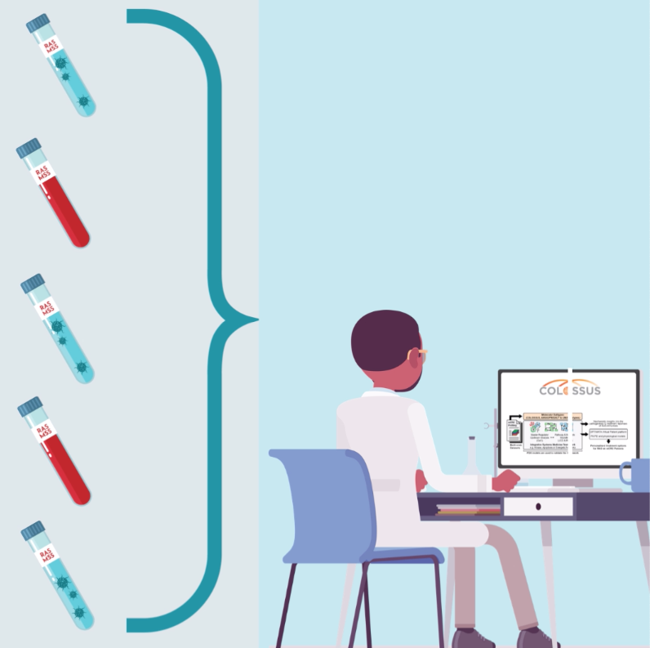
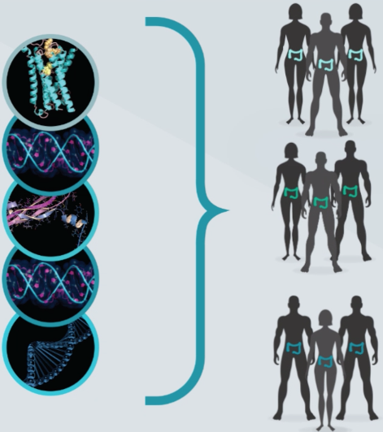
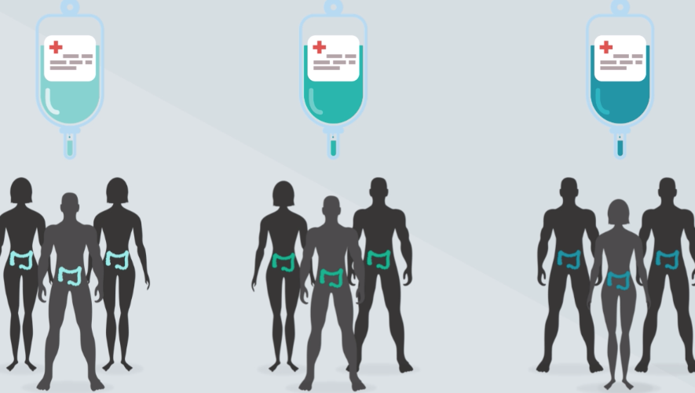














COLOSSUS has received funding from the
European Union’s Horizon 2020 research and innovation programme under grant agreement
no.754923.
Análisis molecular del tumor colorrectal RAS mutado MSS (“frio”)
FUENTES:
BIOBANCOS
& ENSAYOS CLÍNICOS
BIÓPSIAS DE
TUMOR Y
LÍQUIDA
ANÁLISIS DE
DATOS Y MODELOS
PRÉ-CLINICOS
VALIDACIÓN CLÍNICA

